Slide 2















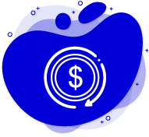
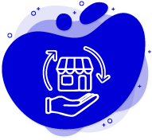
Iconos Portafolio de Servicios

Slide 3
MEJORAS
Neptune is the farthest planet from the Sun and the fourth-largest in our Solar System
LIQUIDACIÓN Y PREMIOS
Despite being red, Mars is a cold place, not hot. It’s full of iron oxide dust, giving the planet its reddish cast
Jupiter is the biggest planet in our Solar System and the fourth-brightest object in the sky

Slide 4
SOFTWARE DEVELOPMENT BUSINESS PLAN
Venus is the second planet from the Sun
Saturn is a gas giant and has rings
VENUS
SATURN
20%
45%
80%
60%
MERCURY
JUPITER
Mercury is the closest planet to the Sun
Jupiter is the biggest planet of them all

